Slide 1

核物理中的有效场论
龙炳蔚
四川大学

Slide 2
A brief intro to nuclear chiral effective field theory
Bingwei Long
Sichuan University

Slide 3

Chiral nuclear effective field theory
— Renormalization and power counting
龙炳蔚
四川大学

Slide 4

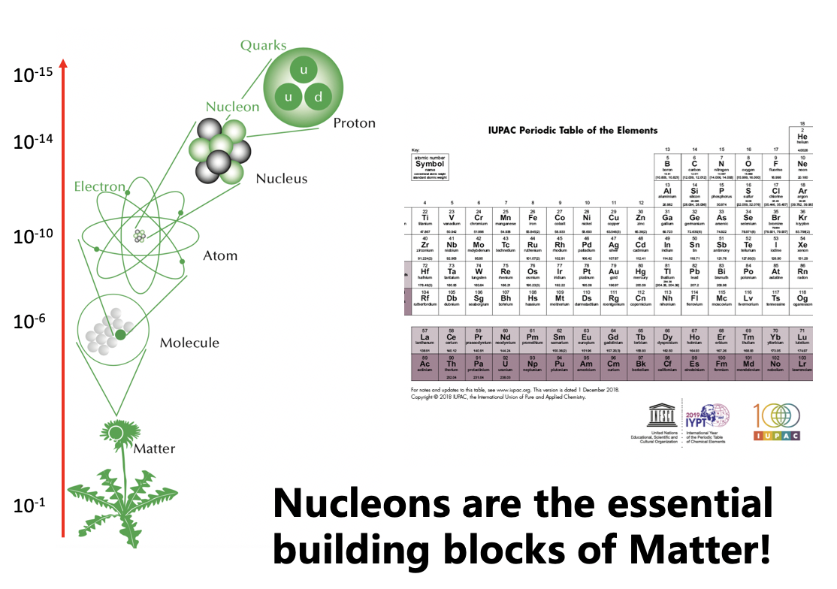
粒子物理与核物理结合，大有可为

Slide 5
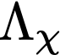
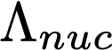
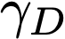
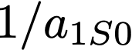
BSM nuclear physics
BSM
ΛBSM
10? TeV
Standard M
MH
100 GeV
1 GeV
chiral sym. breaking
chiral EFT
avg. nucleon momentum inside nuclei
~ 100 MeV
45 MeV
pionless EFT
very small nuclear scales
8 MeV

Slide 6
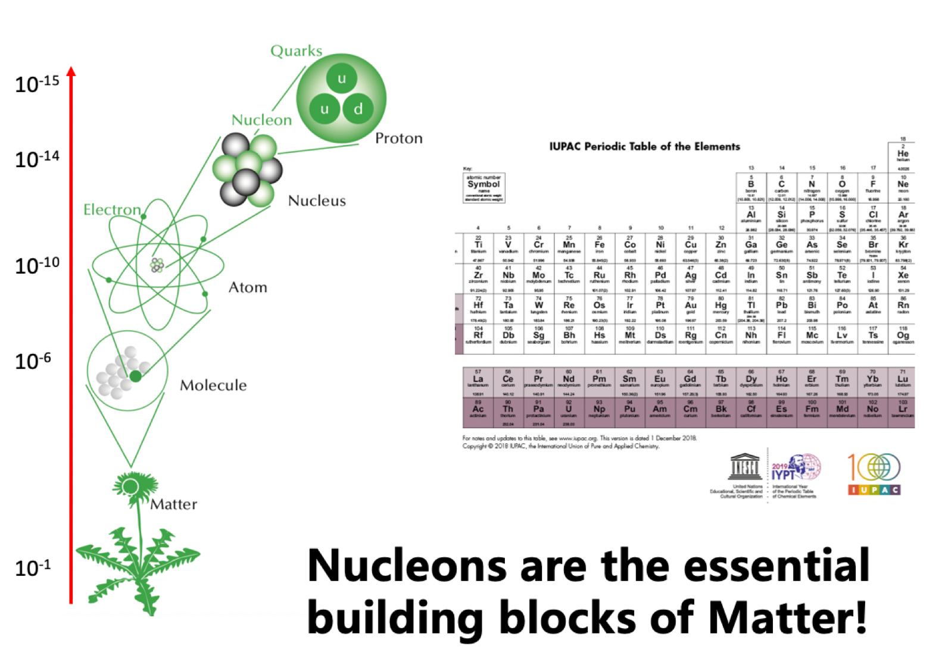
Every theory is an effective theory
unit: m

Slide 7
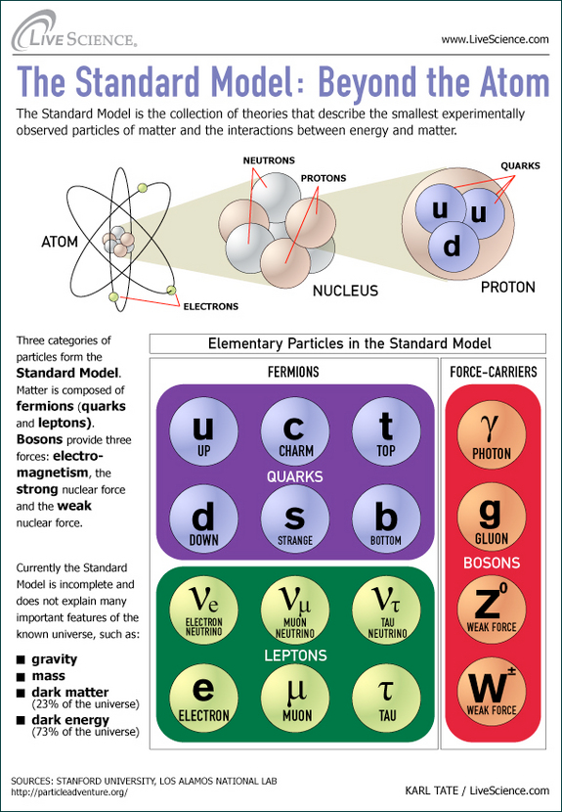
The Standard Model → Nuclear Theory

Slide 8
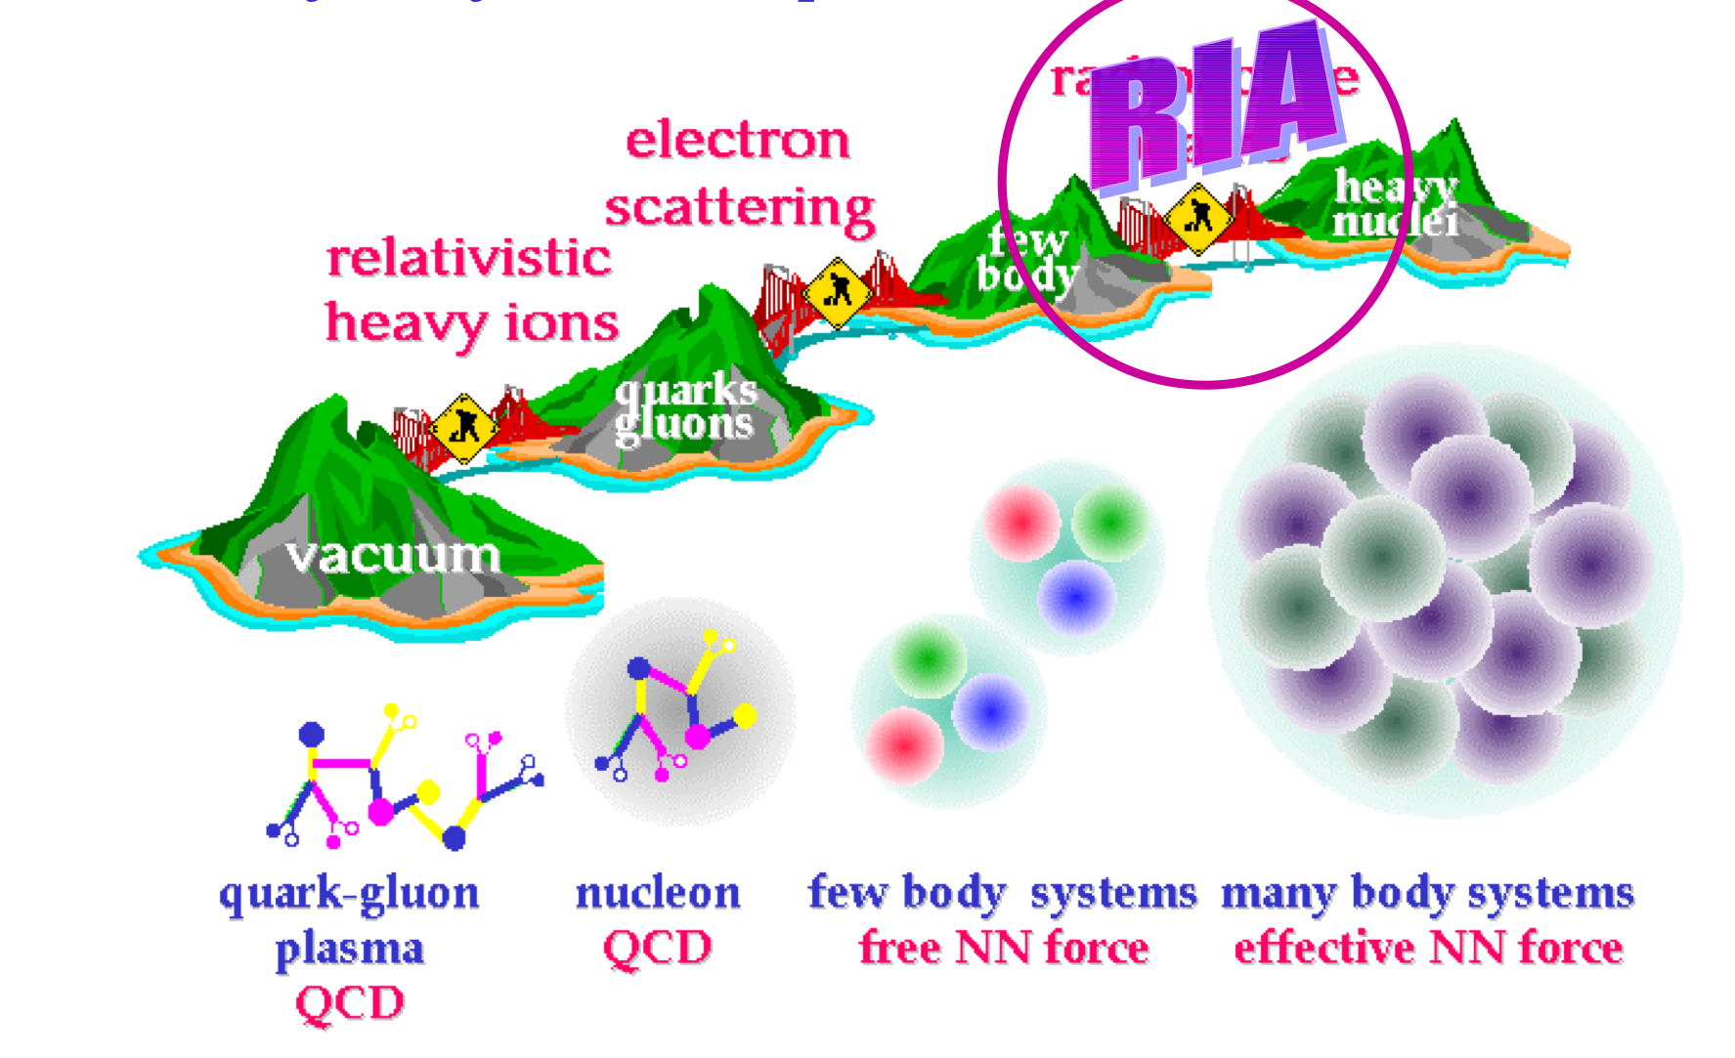
Collaborative efforts

Slide 9
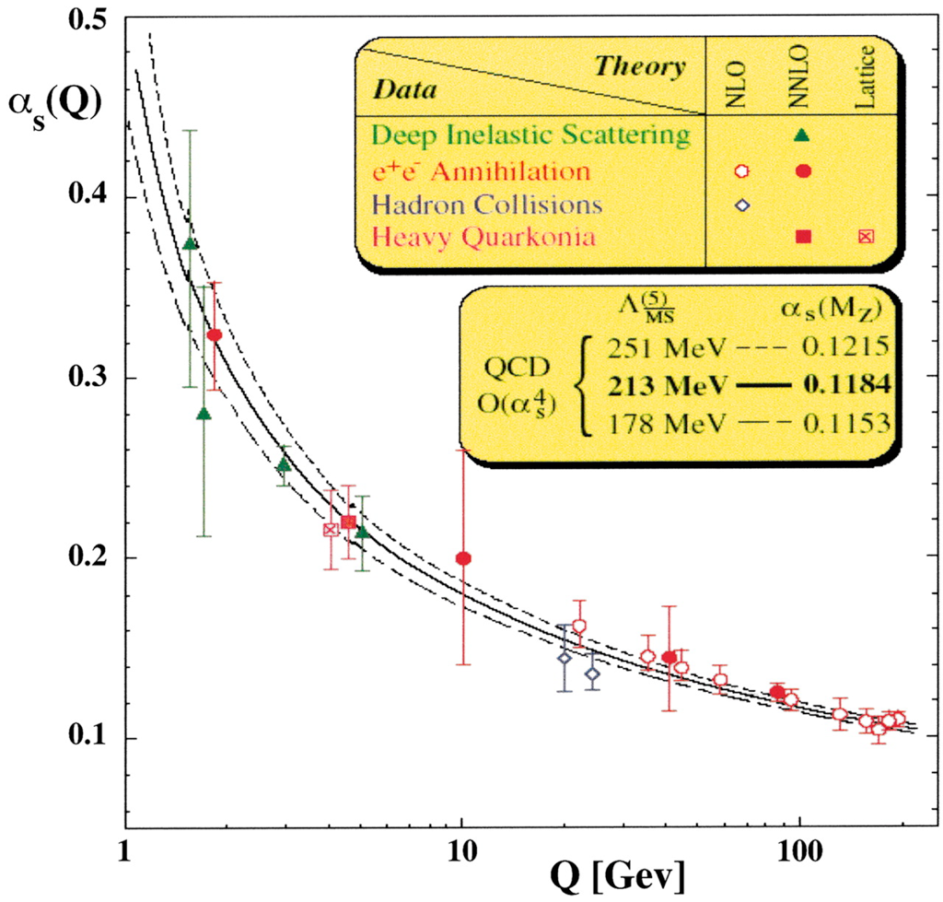
Perturbative QCD N/A
Nucl-ex/th is here!

Slide 10
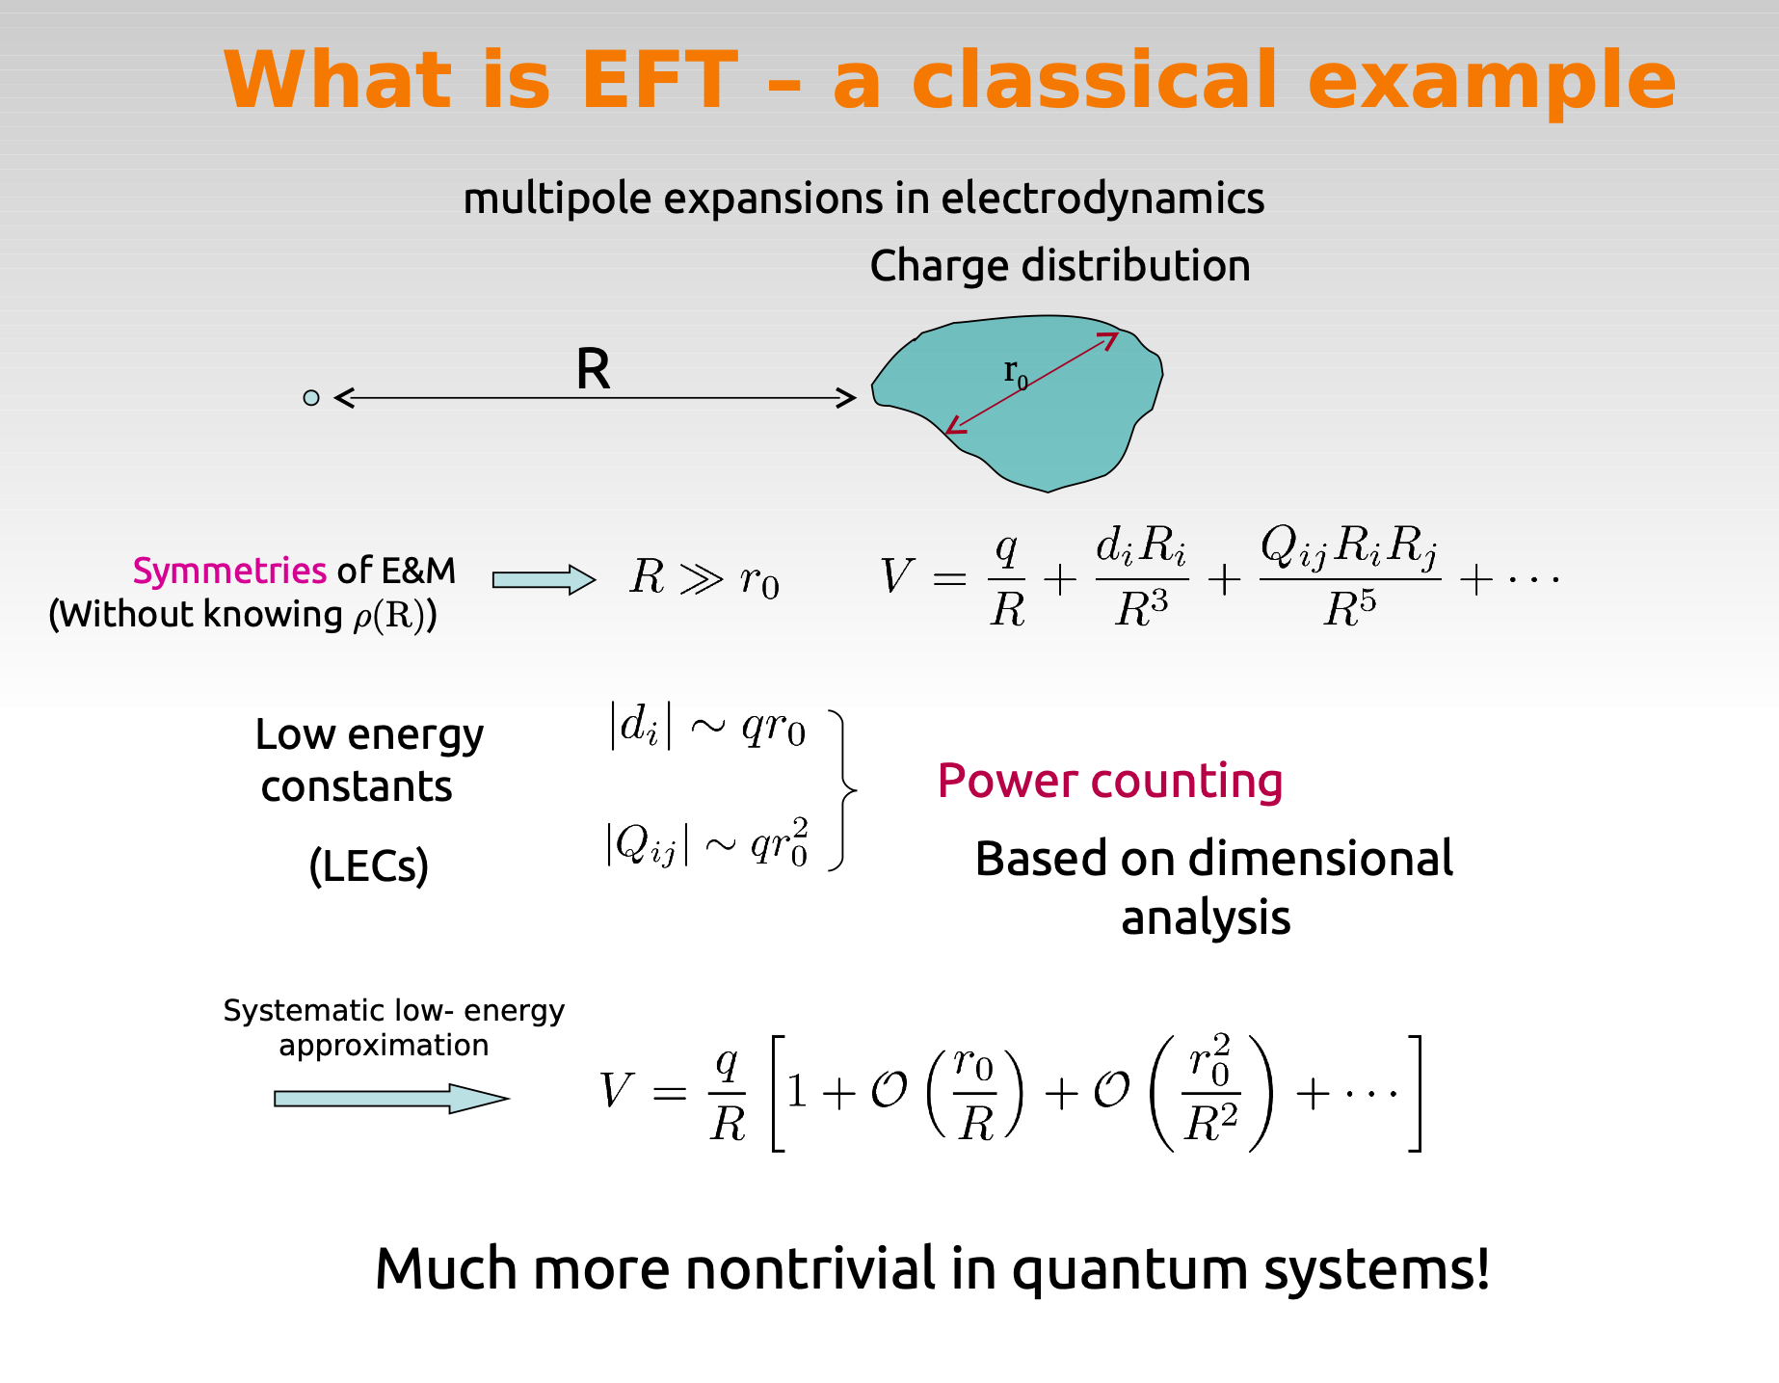
Separation of scales

Slide 11
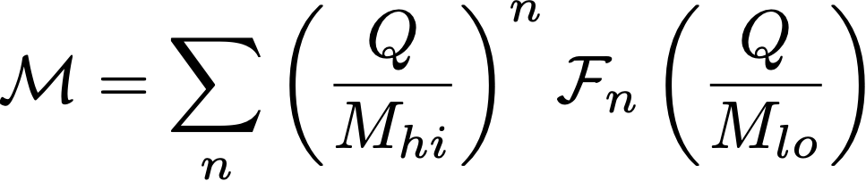

Chiral EFT
Low-energy approximation of QCD, expansion in Q/M_hi Q: small external momenta Mhi : EFT breakdown scale (~500 MeV?)
Q: generic external momenta,
Systematic approximation
→ able to estimate theoretical errors

Slide 12
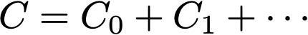
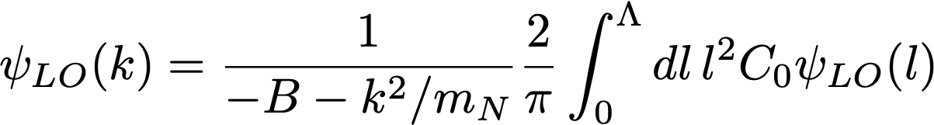
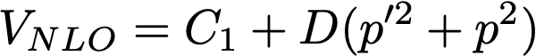
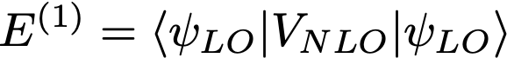
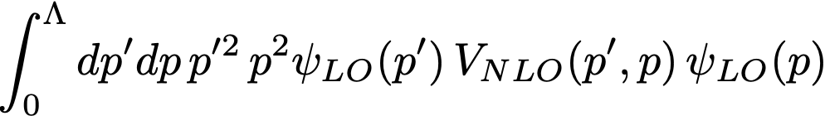
Solution
Formal expansion of C: C0 is VLO, and C1 is NLO correction due to renormalization by D(p’² + p²)
Calculate NLO corr. by perturbation theory

Slide 13
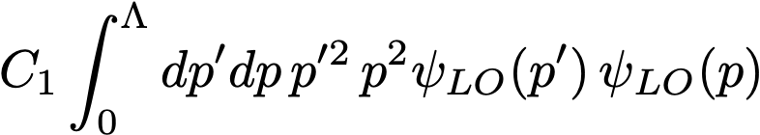
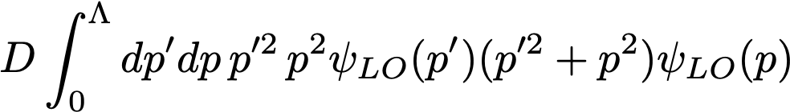
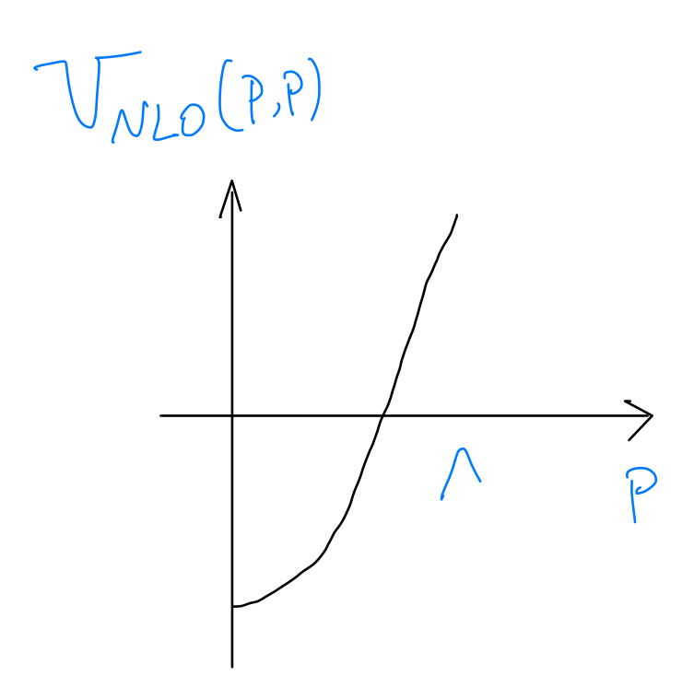
Two large numbers cancel to give small NLO correction
E⁽¹⁾ =
-
V at low p cancels V at high p

Slide 14
Lessons learned
EFTs need UV regularization
Observables independent of UV cutoff
Subleading corrections better be treated in perturbation theory

Slide 15
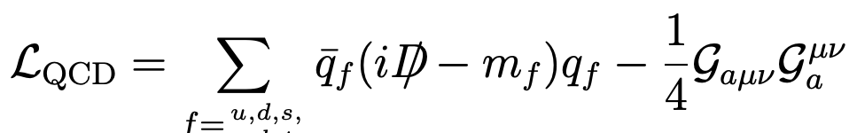
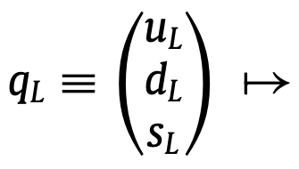
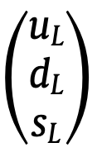
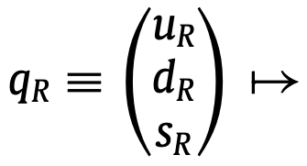
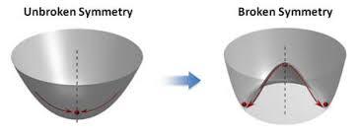
Chiral EFT
Includes all symmetries of QCD, especially (approximate) chiral symmetry and its spontaneous breaking
( )
( )
SU(3)L
SU(3)R
Only two flavors used in our work
Lagrangian invariant when mf → 0, but broken by QCD ground state
→ chiral symmetry nonlinearly realized by hadronic Dofs
CCWZ; Weinberg; …

Slide 16
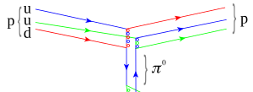

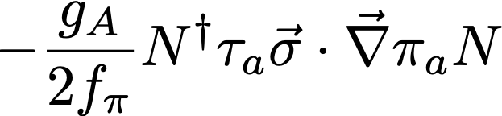
Chiral nuclear EFT
Dofs = nucleons + pions (Quark-gluon interactions encoded in low-energy constants

Slide 17
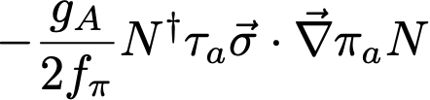
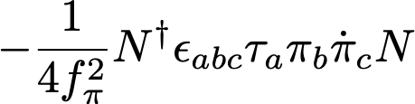
Chiral EFT
The most general Lagrangian has infinitely many parameters
…

Slide 18
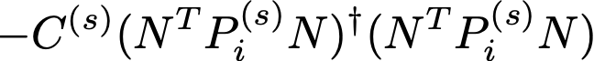
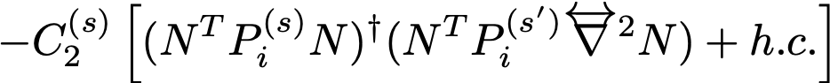
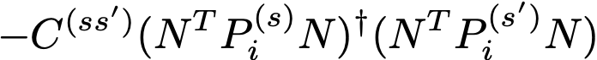
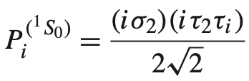
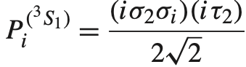
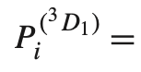
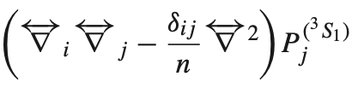
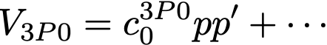
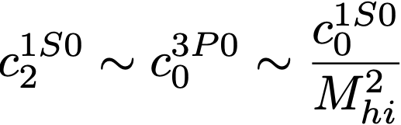
Short-range interactions: large numbers of 4N operators
…
…
s, s’ = ¹S0, ³S1, ³P0, …
NN contact pot. in mom. spapce
Naive dim. analysis (NDA):

Slide 19
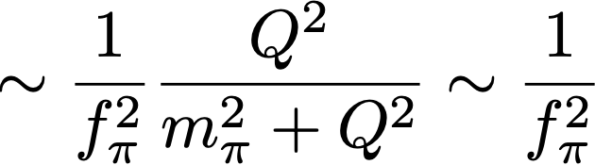
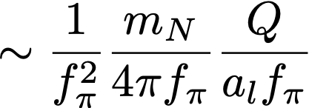
Power counting: long-range physics
Typical size of external momenta:
$$Q∼m_{π}$$
NN reducible
Focus on loop momenta ~ external momenta Q
Pion line or photon line ~ 1/Q² , nucleon line in irreducible diagrams ~ 1/Q
Nucleon line in reducible diagrams ~ mN/Q² ⇒ Explain why we solve the Schrodinger eqn ⇒ Explain why nuclei bound
Strength of OPE ~ $a_{l}f_{π}$ (numerical factor $a_{l}∼1$ for small l, $a_{l}≫1$ for large l by centrifugal suppression)
Notes:
there must be low-energy scales to enhance contacts
MNN is like Bohr radius, emerging out of QM dynamics

Slide 20
Power counting: short-range physics
Renormalizing
Strength of OPE $a_{l}f_{π}$ may have impact on contacts through renormalization
Coexistence of $a_{l}f_{π}$ and $M_{hi}$ makes NDA no longer reliable
Operators gaining large anomalous dimension through nuclear dynamics → “irrelevant” operators become relevant
Notes:
there must be low-energy scales to enhance contacts
MNN is like Bohr radius, emerging out of QM dynamics

Slide 21
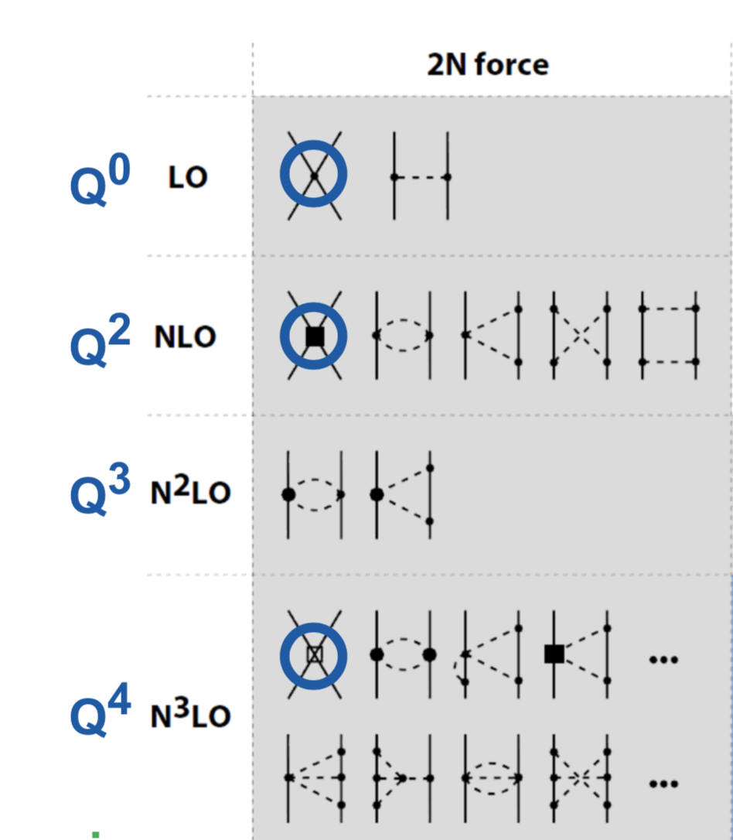
Need to re-examine contact operators
$$\frac{1}{M_{hi}^{2}}$$
24 contacts
in NDA up to Q⁴
$$\frac{1}{M_{hi}^{4}}$$
Notes:
Pion exchange good;
Biggest assumption is NDA, it’d be great if it is correct
NDA is bottom line

Slide 22
Counting short-range operators
At any given order in a power counting scheme, there must be enough operators to satisfy renormalization group invariance ⇒ explicit checking UV cutoff independence ⇒ model independence
In terms of Wilson’s RG 1. Assume O be irrelevant (statement of PC) 2. Run RGE 3. Will O stay irrelevant in EFT?

Slide 23
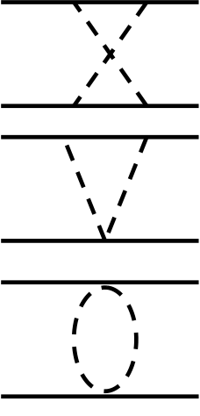
What cutoff?
Potentials: two-nucleon irreducible diagrams
=
…
…
$$V$$
Λ: UV cutoff
Lippmann-Schwinger eqn (equivalent to Schrodinger eqn)
$$T^{(0)}$$
=
$$V^{(0)}$$
+
$$V^{(0)}$$
$$T^{(0)}$$

Slide 24
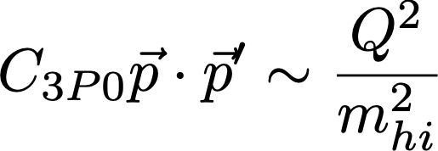
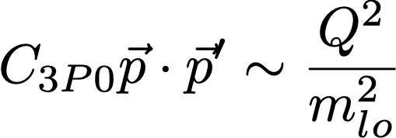
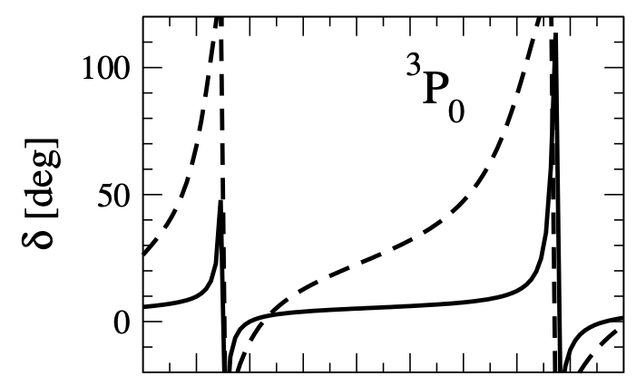
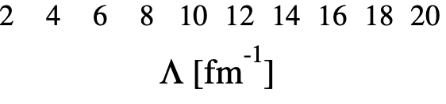
Renormalizing singular attraction
Nogga, Timmerman & van Kolck (2005)
Phase shifts vs. Λ
O(Q²)
O(1)
WPC
RG inv. counting
Contacts needed at LO in attractive triplet channels: 3P2 - 3F2, 3D2, 3D3 …
Solid: Tlab = 10 MeV, dashed: 50 MeV

Slide 25
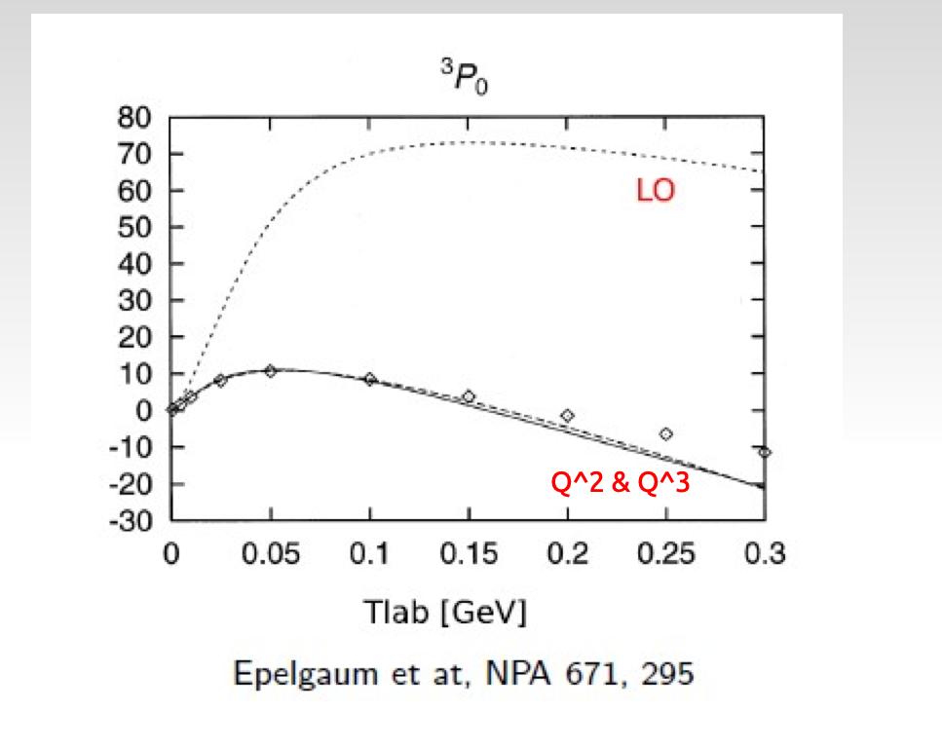
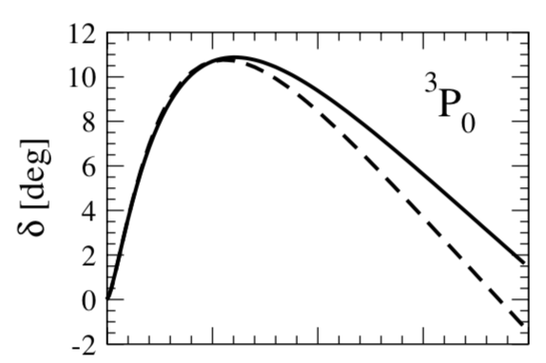
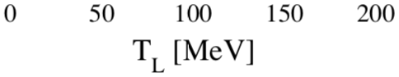
Renormalizing singular attraction
Beane et al (’01)
Pavon Valderrama & Ruiz Arriola (’05 ~ ’07)
Nogga et al (’05)
V
r
V
Vs
r
Unphysical bound states
Modify PC
⟹
$$V_{L}∝-\frac{1}{r^{3}}$$
$$V_{L}∝-\frac{1}{r^{3}}$$
Λ⁻¹
Λ⁻¹
LO
PWA
Nogga et al (’05)
Notes:
Nontrivial that this can be done

Slide 26
Modified power counting for chiral nuclear forces
Nogga et al. ’05
BwL & Yang ’11, ’12
Wu & BwL ’19
LO : (C + OPE) for 1S0, 3S1, 3P0
NLO : Q² C.T. for 1S0; OPE for 1P1, 3P1, 3P2…
N2LO: (Q⁴ C.T. + TPE) for 1S0; (Q² C.T. + TPE) for 3S1-3D1 and 3P0
N3LO: ….
(perturbative OPE for most waves)

Slide 27
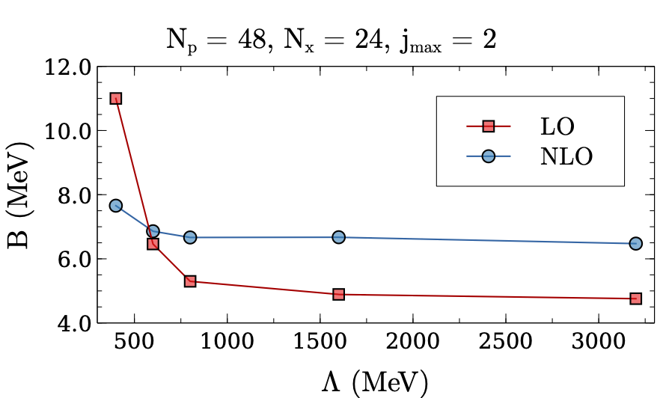
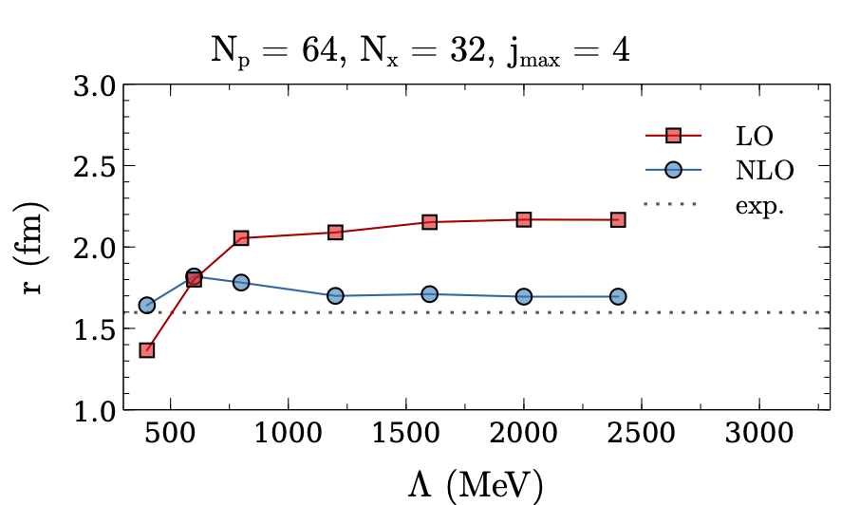
Triton BE and charge radius
Preliminary

Slide 28
nd elastic scattering
Preliminary
Phase shift in degrees (j^{π} = 1/2⁺ , S wave)
Tlab | 1 MeV | 2 MeV | 3 MeV
LO | -20.2 | -28.3 | -37
NLO | -22.2 | -33.1 | -40.4
AV14 | -17.8 | -28 | -34.9

Slide 29







Deuteron decay by NN → NNbar
Oosterhof, BWL, de Vries, Timmermans & van Kolck
PRL 122 (2019) 17, 172501
neutron-antineutron osc.
N
1-body
N
N
N
N
N
N
2-body direct transitions

Slide 30

Direct NN annihilation
N
e.g.
N
To what extent can we disentangle these mechanisms?

Slide 31



Finally…
Oosterhof, BwL, de Vries, Timmermans & van Kolck
PRL 122 (2019) 17, 172501
Re(anbar-p)
NN range
pion
w/ unknown B0
Perturbative pion allows for analytic expression
Loosely bound neutron helps sensitivity (nuclei with neutron halo?)
B0 gives largest uncertainty
W/ nonperturbative pion EFT, unknown LECs may have smaller impact

Slide 32











mπ dep. in NN 1S0
First RG issue found with Weinberg PC
(Kaplan et al. ’96)
$$T^{(0)}$$
$$T^{(0)}$$
χ sym.
to control cutoff error →
promoted to LO
LO
NNLO in WPC
∼ 290MeV

Slide 33


Slide 34


Slide 35


Slide 36
Summary
Chiral EFT has infinite number of LECs → power counting is crucial
NDA good for counting long-range physics, but unreliable for short-range interactions
RG analysis (UV cutoff independence) can be used as guideline to test PC for short-range physics

Slide 37
Nuclear reactions in artificial traps
Artificial traps, e.g., harmonic potential
?
→ Scattering/reaction amplitudes
Busch et al. ’98
Luu, Savage, Schwenk & Vary ’10
Rotureau, Stetcu, Barrett & van Kolck ’10 ’12
Xilin Zhang et al. ’19 ’20

Slide 38


Slide 39








BwL ’13
Sanchez et al. ’17
Still RG inv.
Resum even more C.T.
k0 = 340 MeV(amp. zero)
low-energy scale in LO

Slide 40










Perturbative high partial waves
For L large enough, OPE becomes perturbative
Amplitude
0
=
promoted by one order from WPC
leading TPE
Delta-less
subleading TPE (w/ ci’s)

Slide 41





3P0 is not pert
Hoefrichter et al. ’15, ’16

Slide 42


Slide 43
Saga of 1S0
First RG issue found with Weinberg PC
(Kaplan et al. ’96)
χ sym.
In order to contral cutoff error →
as important as C0
LO
NNLO in WPC
∼ 290MeV

Slide 44




Saga of 1S0
NLO not vanishing
LO cutoff error =
Larger than NNLO C.T. can compensate
→ NLO
(BwL & Yang ’12)
Formal RG analysis: Birse ’06, Pavon Valderrama ’09
First RG issue found with Weinberg PC
(Kaplan et al. ’96)
LO

Slide 45
Saga of 1S0
First RG issue found with Weinberg PC
(Kaplan et al. ’96)
LO
NLO not vanishing
LO cutoff error =
Larger than NNLO C.T. can compensate
→ NLO
(BwL & Yang ’12)
Formal RG analysis: Birse ’06, Pavon Valderrama ’09

Slide 46


Slow convergence in 1S0
BwL & Yang ’12
(Pavon Valderrama ’09)
LO
NNLO
NLO
Additional low-energy scale “emerging” from underlying theory?

Slide 47



Partially resumming energy (momentum) dep. contacts
Auxiliary ¹S0 dibaryon field
(Kaplan ’96; Soto & Tarrus ’08; BwL ’13)
RG inv.
perturbations !

Slide 48

LO
LO
NNLO
NNLO
NLO
NLO
Improved convergence
Resolved pion-mass dep. issue

Slide 49
Resum even more C.T.
BwL ’13
Sanchez et al. ’17
Still RG inv.
k0 = 340 MeV(amp. zero)
low-energy scale in LO

Slide 50




No change to WPC in 3S1-3D1, subleading orders in pert.
BwL & Yang ’11

Slide 51
No change to WPC in 3S1-3D1, subleading orders in pert.
BwL & Yang ’11
(Pavon Valderrama ’11)

